Slide 1
Linked Lists

Slide 2
C++ Standard Template Library (STL)
The C++ STL (Standard Template Library) is a powerful set of C++ template classes to provide general-purpose classes and functions with templates that implement many popular and commonly used algorithms and data structures like vectors, lists, queues, and stacks.
At the core of the C++ Standard Template Library are following three well-structured components −
No. | Component & Description
1 | Containers are used to manage collections of objects of a certain kind. There are several different types of containers like deque, list, vector, map etc.
2 | Algorithms act on containers. They provide the means by which you will perform initialization, sorting, searching, and transforming of the contents of containers.
3 | Iterators are used to step through the elements of collections of objects. These collections may be containers or subsets of containers.
https://en.cppreference.com/w/

Slide 3
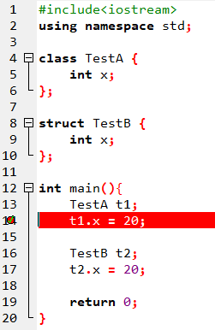

Recap: Struct vs Class in C++
How are structures not secure?
Members of a class are private by default and members of a struct are public by default.

Slide 4
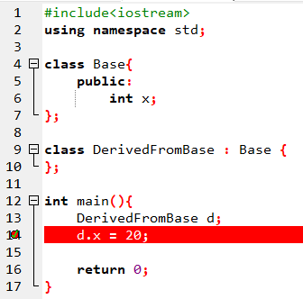
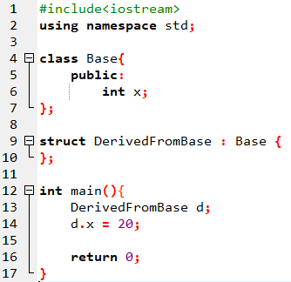
When deriving a struct from a class/struct, default access-specifier for a base class/struct is public. And when deriving a class, default access specifier is private.
Inheritance: Private vs Public

Slide 5
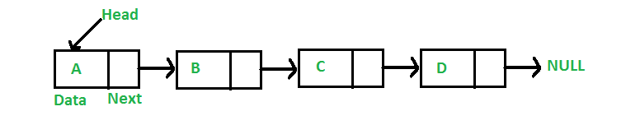
Introduction to Linked Lists
Linked Lists are a linear data structure. Unlike arrays, linked list elements are not stored at a contiguous location; the elements are linked using pointers.
Why Linked List?
Arrays are useful but have the following limitations:
Fixed size.
Allocated memory remains to be the upper limit.
Expensive operations (such as insertion) which requires movement of all existing elements and creation of room for new elements.

Slide 6
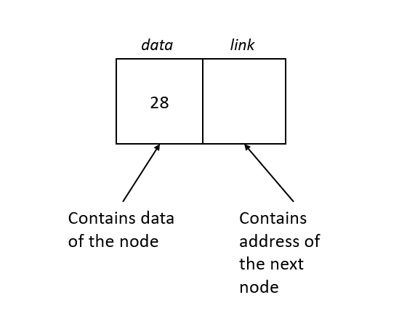
Linked Lists vs. Arrays
Advantages over Arrays
Dynamic size
Ease of insertion/deletion
Drawbacks
Random access is not allowed. We have to access elements sequentially starting from the first node
Extra memory space for a pointer is required with each element of the list.
Not cache friendly. No locality reference.
Representation:
A linked list is represented by a pointer to the first node of the linked list. The first node is called the head. If the linked list is empty, then the value of the head is NULL.
Each node in a list consists of at least two parts:
Data
Pointer (Or Reference) to the next node

Slide 7
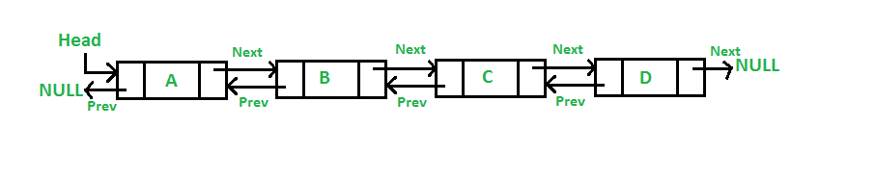
Doubly Linked Lists
Traversed in either direction. It is a linked list in which every node has a next pointer and a backpointer.
Every node contains address of next node (except the last node).
Every node contains address of previous node (except the first node).
Typical operations:
Initialize the list
Destroy the list
Determine if list empty
Search list for a given item
Insert an item
Delete an item, and so on

Slide 8

Simply Linked List
Create a simple linked list with your name, in this case "ROMAN"
Step 1: Create the node pointers
Step 2: Create new nodes and allocated in the heap
Step 3: Define every node in the list
Step 4: Point last node to NULL

Slide 9
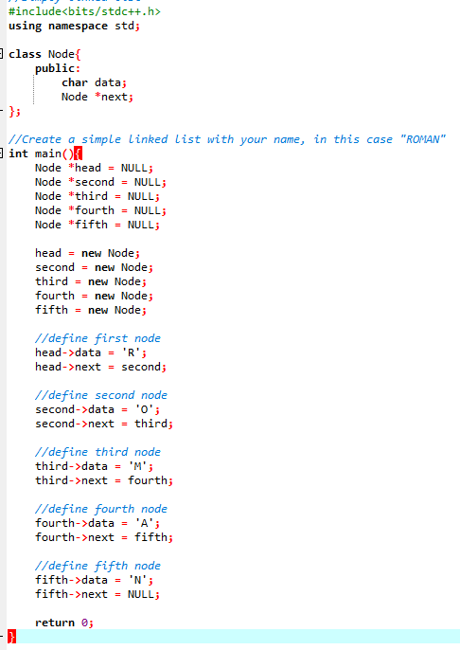
Simply Linked List: Implementation

Slide 10
Linked List Traversal
Algorithm: ListTraversal (parameter: pointer to node n)
WHILE n IS NOT EQUAL TO null
PRINT data OF n
GO TO NEXT NODE n := next
ENDWHILE
PRINT next line
END

Slide 11
Node Insertion
Sometimes we have a linked list and we need to insert a node somewhere other than at the end of the list. We will take a look at a couple of different ways to insert a node into an existing list
A new node can be added to a linked list in one of three ways
At the front of the linked list
After a given node.
At the end of the linked list.

Slide 12
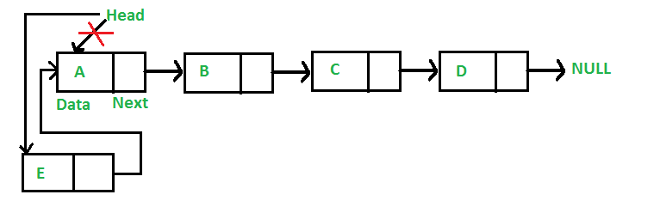
Node Insertion at head
Steps:
Allocate memory for the new node
Put our data into the new node
Set Next of the new node to point to the previous Head
Reset Head to point to the new node
Notes:
This code performs our 4 steps:
allocate memory for a new node called new_node (you can call it whatever you want)
we insert the data, that was passed in as an argument, into the data field of the Node we just created
take the head_ref pointer, that points to the original head, and set the next field of the new node to point at the previous head
take the address of the new_node and reset the head_ref to point to this new node as the head of the linked list

Slide 13
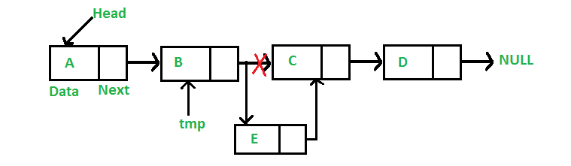
General Node Insertion
Steps:
Check if it is the head node (previous node is null)
If null, print "Previous node cannot be null."
Allocate a new node
Store data in the new node
Point new node to the node previous node was pointing to
Point previous node to the new node

Slide 14
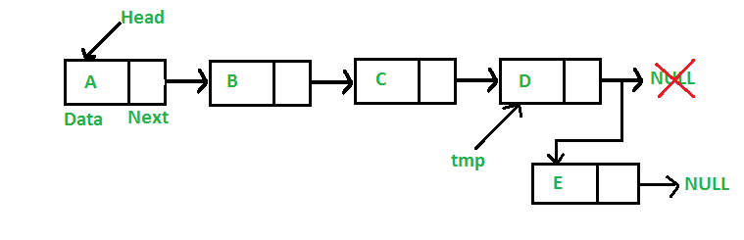
Insert Node at the End
Steps:
Allocate new node
Dereference to the head node
Store data in new node
Point next of new node to NULL
Traverse the list until next of the node is null
Point the next of the current node to the new node

Slide 15
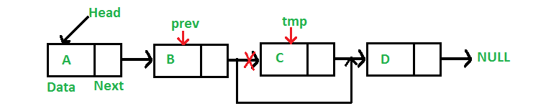
Delete a Node
To delete a node from linked list, we need to do following steps.
1) Find previous node of the node to be deleted.
2) Change the next of previous node.
3) Free memory for the node to be deleted.

